Slide 1
Strategies to Get ‘em, Keep ‘em, and Complete ‘em -GateWay Community College-

Slide 2
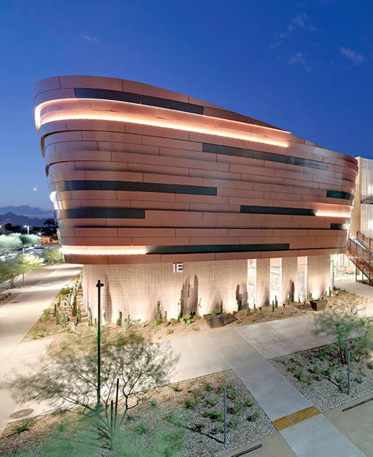
GateWay History & Background
Established in 1968 as Maricopa Technical College
Became GateWay Community College in 1987
Serve over 11,000 students annually at multiple campus locations
Washington, Central City, Deer Valley, Surprise, Southwest Skill Center
Draw students from every zip code in Maricopa County
Notes:
K. Gubser

Slide 3
Achieve60 & MCCCD Transformation
Notes:
K. Gubser

Slide 4
What We Do. - Get ‘em
Credit Programs
Transfer articulation agreements to multiple universities
Certificate of Completion - stackable
Associate Degree of Applied Sciences
Credit continuing education
Clock Hour Programs
Certification of Competency
Stackable Industry Credentials
Non-credit custom training
Notes:
N. Johnson & C. Wurster
Get’em, Keep’em, and Complete’em strategies are all focused on moving GWCC to a “Student Ready” institution.

Slide 5
What We Do. - Get ‘em
Unique Programs (Not inclusive)
Business and Information Technology – both credit and clock opportunities
Industrial Technology – both credit and clock opportunities
Health Sciences – both credit and clock opportunities
Nursing – CNA, Advanced Placement LPN, Veteran’s Bridge Program, ADN & Concurrent Enrollment Program to BSN
Beauty and Wellness – clock opportunity
Notes:
N. Johnson

Slide 6
How Do We Do It? - Get ‘em & Keep ‘em
Support Services
Faculty Advising
Career Services
New Student Orientation, Gecko Gear Up, First Year Experience
Student Success Programs - ACE, HOOP, EXCEL, TRIO
GateWay Early College High School
ESP 110 & CPD 150
Children’s Learning Center
Occupational Advisory Councils
Notes:
C. Wurster

Slide 7
Competitive Advantages - Get ‘em & Keep ‘em
Center for Entrepreneurial Innovation (CEI)
Makerspace
Services to the Community
Healthcare United at GateWay (HUG) Pro Bono Clinic – services in Physical Therapy, Sonography & Respiratory Care
Meat Cutting Retail Shop
Cosmetology/Aesthetician/Massage Therapy services
Autobody services
Nursing and Health Sciences Continuing Education Workshops
Leveraging resources through placemaking
City of Surprise, Youth Build, First Place, ASU
Notes:
K. Gubser

Slide 8
How We Partner. - Keep ‘em & Complete ‘em
Cyber Warfare Range
Johnson Controls
Apprenticeship Programs
Surprise Water Treatment Facility
Year Up
Joint Technical Education Districts (JTEDs)
West-MEC (Western Maricopa Education Center) partnership at Deer Valley
West-MEC Dual Enrollment at North East Valley for Manufacturing Technology
East Valley Institute of Technology (EVIT) working in Adult Education Occupational Therapy Assistant program
Notes:
N. Johnson

Slide 9
What Is the Future? - Complete ‘em
Competency-Based Learning
Credit for Prior Learning
Industry Institutes
Guided Pathways Structure
Career Navigators
Community Education
One-Stop Access Point
Notes:
C. Wurster

Slide 10
Questions/Discussion
Notes:
C. Wurster

