Slide 1
Arizona Pathways to Prosperity
Strengthening Arizona’s Talent Pipeline
December 8, 2017
Developing Arizona’s Human Capital Conference
Dr. Amanda Burke

Slide 2
Arizona Pathways to Prosperity
Systemic coordination and alignment across education, workforce, and industry = strong talent pipeline.

Slide 3
Arizona Pathways to Prosperity
Our Goals:
Ensure that many more young people in Arizona complete high school and earn a postsecondary credential with labor market value in their community.
Create systems of career pathways that align with the state and regional economies.

Slide 4
Arizona Pathways to Prosperity
Career pathways span grades 9-14+ and provide young people with the skills and credentials that can enable them to get started in a high-demand, high-growth field.

Slide 5
Arizona Pathways to Prosperity
Building a Statewide Career Pathways System – Our Strategies
Design, implement and refine comprehensive industry-driven early college career pathways.
Develop, scale and sustain a continuum of meaningful work-based learning experiences for students in grades 7-14+.
Integrate our education and workforce development efforts and data systems.
Expand visibility and facilitate public support for comprehensive career pathways that align with state and regional economies.
Coordinate financial support across public, private, and philanthropic communities to implement and scale career pathways.

Slide 6
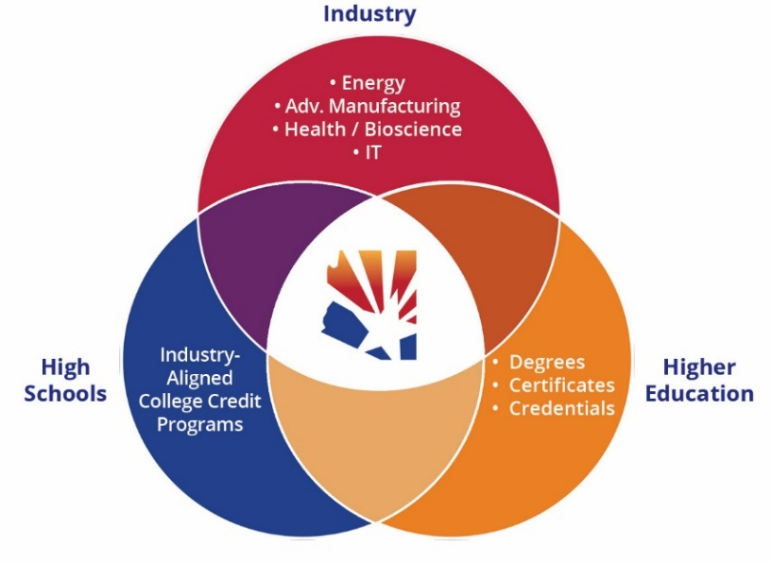
Partnership and Collaboration – 60+ Partners and Growing
Jobs for the Future and Harvard Graduate School of Education
Greater Phoenix Chamber of Commerce
Arizona Office of Economic Opportunity (AOEO)
Tucson Mayor’s Office
Southern Arizona Manufacturing Partners (SAMP)
Maricopa Community College District
Pima Community College District
Arizona Department of Education
25+ Arizona high schools

Slide 7
Arizona Pathways to Prosperity
Why It Matters – Significant Return On Investment
Students
Middle and high school success
Employers
Skills gap/talent shortage addressed
Postsecondary success
Career and community success
Pipeline of young professionals
Increasing number of jobs
Economies
State and regional economies thriving and growing in key industry sectors
Providing upward mobility

Slide 8
Contact Information:
Dr. Amanda Burke
Center for the Future of Arizona
Senior Director, Education and Workforce
amanda.burke@arizonafuture.org
602.496.2037

